Slide 1
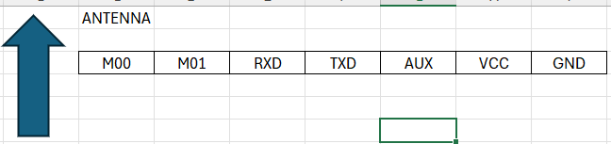
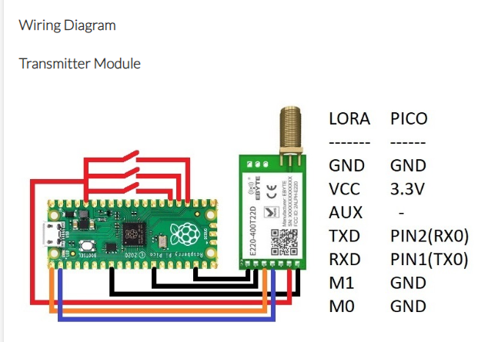
https://www.micropeta.com/video24
Button – GPIO 15
Red LED – GPIO 18
GPIO 1
GPIO 0
lora = UART(0,9600,tx=Pin(0),rx=Pin(1))

Slide 2
#Transmitter code starts here
import utime
from picozero import LED
from machine import UART
from machine import Pin
lora = UART(0,9600,tx=Pin(0),rx=Pin(1))
led=LED(14)
switch1 = Pin(15, Pin.IN, Pin.PULL_DOWN)
while True:
if switch1.value():
print('SECRET111')
lora.write("SECRET111")
led.on()
else:
lora.write("SECRET110")
print('SECRET110')
led.off()
utime.sleep(0.2)
#Transmitter code Ends here

Slide 3
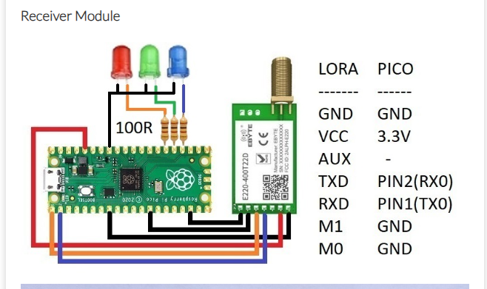
https://www.micropeta.com/video24
Red LED – GPIO 19
Blue LED – GPIO 14
GPIO 1
GPIO 0
lora = UART(0,9600,tx=Pin(0),rx=Pin(1))

Slide 4
#Receiver code starts here
import utime
from machine import UART
from machine import Pin
lora = UART(0,9600,tx=Pin(0),rx=Pin(1))
led_red = machine.Pin(19, machine.Pin.OUT)
led_blue = machine.Pin(18, machine.Pin.OUT)
led_red.value(0)
led_blue.value(0)
while True:
print('waiting...')
dataRead = lora.readline()
print(dataRead)
if dataRead is not None and "SECRET111" in dataRead:
print('111')
led_red.value(1)
led_blue.value(0)
elif dataRead is not None and "SECRET110" in dataRead:
print('110')
led_red.value(0)
led_blue.value(1)
utime.sleep(0.2)
#Receiver code Ends here

